Slide 1

Segmentation Systems in Marketing
Max Kilger,Ph.D.
Department of Marketing
UTSA
MKT6971

Slide 2
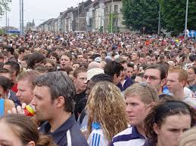
Mass Marketing vs. Market Segmentation
Mass Marketing
Ignores most of the differences of customers and prospects in the marketplace
Targets a wide audience often with a shotgun approach
Lower research costs
Less chance of misreading customer cues and characteristics

Slide 3

Mass Marketing vs. Market Segmentation
Market Segmentation Approach
Utilizes information about customers and prospects to precisely target customers and prospects
Builds different customer/prospect segments, each with its own unique characteristics and qualities
Requires significant investment in research
More efficient use of advertising dollars

Slide 4
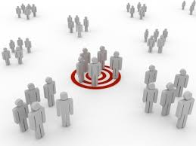
Targeting as a Key Concept in Market Segmentation
Key questions to answer in market segmentation
Who are my customers? What do they look like?
How do I reach them?
What are the messages that I want to use to most effectively convince them?
What are the differences between customers and prospects?

Slide 5
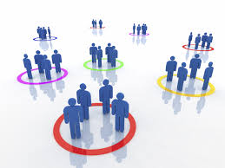
Idea of Multiple Customer Segments
Critical concept of multiple customer segments
Your customers do not all look alike
Your customers can be described as belonging to one of a number of different customer segments

Slide 6
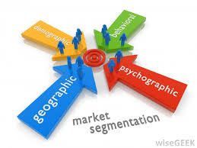
How Do I Place My Customers Into Market Segments?
Market segmentation systems often use the following to create market segments:
Demographics
Geography
Behaviors
Psychographics
And more…

Slide 7


Off-The-Shelf vs. Custom Market Segmentation Systems
vs
Two different paths typically taken in applying market segmentations systems
Off the shelf systems like Mosaic, Prizm, Personicx, Tapestry, ConneXions
Develop a customized segmentation system

Slide 8
Off-the-shelf Segmentation Systems
Personicx Example

Slide 9
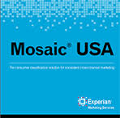
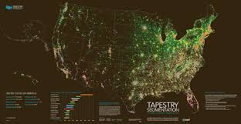


Off-The-Shelf Market Segmentation Systems
Consumer lifestyle household segmentation system utilizing demographics, geographic location and behavior. 71 segments and 19 groups.
Household level segmentation system based on demographics and socioeconomic variables. 65 segments.
Consumer life-stage household segmentation system utilizing demographics, geographic and life stage events. 70 segments and 21 life-stage groups.
Consumer household segmentation system utilizing demographics and geographic urbanization information. 66 segments..

Slide 10
ORDER OF CONTENTS
INTRODUCTION
PersonicX Classic Cluster Quick Reference (organized by life stage group) PersonicX Classic Cluster Quick Reference (organized by cluster code)
PERSONICX CLASSIC GROUP/CLUSTER PERSPECTIVES
01Y BEGINNINGS 12B FLUSH FAMILIES
ORDER OF CONTENTS
Cluster 39
Cluster 45
Cluster 57
Cluster 58
Cluster 67
Early Parents First Digs Collegiate Crowd Young Workboots Rolling Stones
Cluster 13
Cluster 17
Solid Single Parents Apple Pie Families
13B TRUE BLUES
Cluster 38
Cluster 48
14B OUR TURN
Cluster 16
Cluster 22
Cluster 31
Cluster 32
Cluster 33
Midtown Minivanners Farmland Families
02Y TAKING HOLD
Cluster 18
Cluster 21
Cluster 24
Cluster 30
Married Sophisticates Children First
Career Building Spouses & Houses
Country Single Fun & Games Mid Americana Metro Mix Urban Tenants
03X TRANSITION TIME
Cluster 34
Cluster 41
Cluster 46
Outward Bound Truckin’ & Stylin’ Home Cooking
15M MATURE WEALTH
Cluster 02
Cluster 03
Established Elite Corporate Clout
04X FLYING SOLO
16M AGING UPSCALE
Cluster 42
Cluster 52
Cluster 59
First Mortgage Resolute Renters Mobile Mixers
Cluster 14
Cluster 15
Cluster 23
Career-Centered Singles Country Ways
Acred Couples
05X FAMILY FOCUSED
17M MODEST MEANS
Cluster 37
Cluster 62
Cartoons & Carpools Kids & Rent
Cluster 43
Cluster 44
Cluster 55
Cluster 63
Cluster 68
Work & Causes Community Singles Humble Homes Downtown Dwellers Pennywise Proprietors
06X MIXED SINGLES
Cluster 61
Cluster 69
Cluster 70
Urban Scramble Pennywise Mortgagees Resilient Renters
18M MATURE RUSTICS
07X CASH & CAREERS
Cluster 40
Cluster 50
Cluster 54
The Great Outdoors Rural Retirement Still Truckin’
Cluster 06
Cluster 10
Cluster 20
Cluster 26
Shooting Stars Hard Chargers Dynamic Duos Savvy Singles
19M GOLDEN YEARS
Sitting Pretty Full Steaming Platinum Oldies
08X JUMBO FAMILIES
Cluster 05
Cluster 08
Cluster 09
Cluster 11
Cluster 12
Cluster 19
Cluster 27
Kids & Clout Tots & Toys Country Comfort Soccer & SUVs
20S ACTIVE ELDERS
Cluster 25
Cluster 28
Cluster 36
Clubs & Causes Suburban Seniors Raisin’ Grandkids
09B MIDDLING SINGLES
Cluster 29
Cluster 35
Cluster 56
City Mixers Solo and Stable Modest Wages
21S LEISURE BUFFS
Cluster 49
Cluster 51
Cluster 64
Cluster 65
Cluster 66
Devoted Duos Family Matters Rural Everlasting Thrifty Elders Timeless Elders
10B MIXED MIDDLERS
Cluster 47
Cluster 53
Cluster 60
Rural Parents Metro Parents Rural Rovers
11B FORTUNES & FAMILIES
Cluster 01
Cluster 04
Cluster 07
Summit Estates Skyboxes & Suburbans Lavish Lifestyles

Slide 11
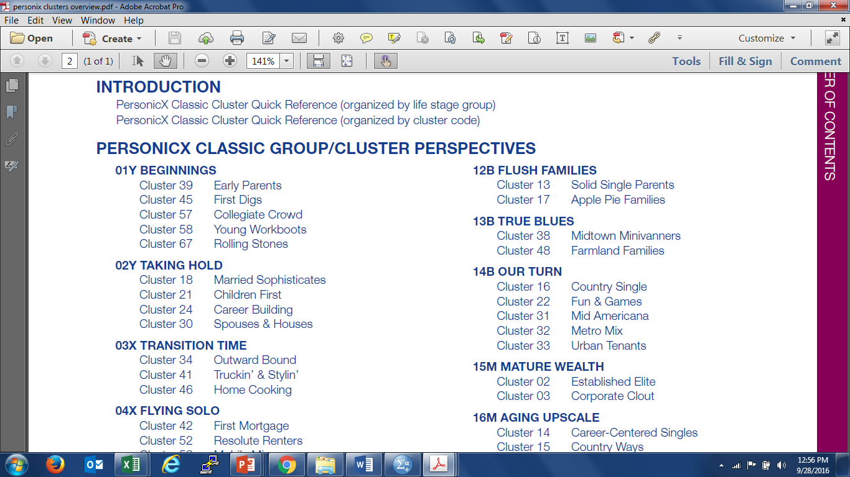

Slide 12
Rolling Stones Details

Slide 13

Applying Segmentation Systems: Customer Database
Because almost every household in the US has a Personicx cluster
Companies can append the Personicx cluster to their customer database
New enhanced customer database much more powerful
What is the distribution of segments across the database?
Which segments over-index or under-index against US?
Which segments buy the most? Which ones buy the most expensive products?
What do my customers look like according to the segment descriptions?

Slide 14
Personicx Taking Taking Hold Group by Distribution in Tide Customer Database
Index=173
Index=110
Simulated data

Slide 15
What is an index?
Here is an example from our data…
We know from Personicx that 1.65% of households in the US are in the “Children First” segment – that is our baseline
We know from our customer database that 2.6% of our customer households are Children First households
Divide 2.6% by 1.65% or .026 / .0165 = 1.73
Multiply 1.73 by 100 = 173, that is the index for Children First in our customer database compared to the US population
You can interpret this by saying “Children First households are 1.7 times more prevalent in our database than in the US population”.
This gives you an idea of how your customer database compares to the US population in general

Slide 16
What is an index? – Let’s try another…
Here is an example from our data…
We know from Personicx that 0.49% of households in the US are in the “Spouses and Houses” segment – that is our baseline
We know from our customer database that 0.25% of our customer households are Spouses and Houses households
Divide 0.25% by 0.49% or .0025 / .0049 = 0.51
Multiply 0.51 by 100 = 51, that is the index for Spouses and Houses in our customer database compared to the US population
You can interpret this by saying “there are about half as many Spouses and Houses households in our database than you would expect given their incidence in the US population”
This gives you an idea of how your customer database compares to the US population in general

Slide 17
In General, in Interpreting an Index…
When the index is above 100, then there is a higher incidence of the group or characteristic in the group you are examining than in the baseline group
When the number is below 100, then there is a lower incidence of the group or characteristic in the group you are examining than in the baseline group
An index of 100 means that the group you are examining has the same incidence or level of characteristics as the baseline group
The comparison or baseline group is often the US population, but it doesn’t have to be…it can be any comparison group that is useful to your interpretation

Slide 18
Off-the-shelf Segmentation Systems
Mosaic Segmentation System Example

Slide 19
Go to Mosaic Groups and Clusters PDF
Then Oneview demonstration

Slide 20
Custom Segmentation Systems

Slide 21
Custom Market Segmentation Systems
Custom segmentation systems are often built for a specific purpose and brand
Some systems may just be developed using already syndicated measures and data
Cheaper since no data collection
Take advantage of all the related syndicated measures
Some systems are more custom and require collection of primary data
Most costly because it requires measure development and data collection

Slide 22
Custom Market Segmentation Systems
Collecting primary data for custom segmentation system
One effective way to do this is to do a “recontact” of syndicated survey respondents
This allows you to collect your custom measures and then merge them with the already collected data
If not a recontact, then be sure you collect all the measures you need

Slide 23
Custom Market Segmentation Systems
Collecting primary data for custom segmentation system
Sometimes the data is collected from client’s own customer database
Custom segmentation measure data is collected from a subset of customers
Custom segmentation is then built
Statistical model is then constructed to model the segments from the subset of the customer database to the rest of the customers
Statistical
Model

Slide 24
Custom Market Segmentation Systems
What kinds of measures are custom built segmentation systems built of?
Less emphasis on demographics and geography – more emphasis on behavior and psychographics

Slide 25
Example Set of Measures as Segmentation Drivers
Think carefully about the characteristics that you want to discriminate your customers by…
I like to use coupons to save money when I shop
I usually wait until the item I want goes on sale before I buy it
I will compare prices from store to store to get the best deal
I often buy things that I know will impress my friends
I usually shop for the latest in fashion
Designer labels usually mean better quality products
When I find a brand that I like, I usually stick with it
When I see a brand I use advertised, I usually pay attention to the advertisement
It is important to me that I can count on the quality of a brand name product

Slide 26
Constructing Abstract Concepts for Segmentation Drivers
I like to use coupons to save money when I shop
I usually wait until the item I want goes on sale before I buy it
I will compare prices from store to store to get the best deal
Cost Conscious

Slide 27
Constructing Abstract Concepts for Segmentation Drivers
I often buy things that I know will impress my friends
I usually shop for the latest in fashion
Designer labels usually mean better quality products
Style Conscious

Slide 28
Constructing Abstract Concepts for Segmentation Drivers
When I find a brand that I like, I usually stick with it
When I see a brand I use advertised, I usually pay attention to the advertisement
It is important to me that I can count on the quality of a brand name product
Brand Loyal

Slide 29
Applying the Clustering Algorithm
We now have our three concepts/variables – Cost Consciousness, Style Consciousness and Brand Loyalty - that we will use to put people into clusters or segments
The clustering algorithm tries to do two things simultaneously
Create segments that are as distinct from each other as possible in terms of the three concepts
Create segments so that people within a single cluster as are alike as possible across the three concepts
As we mentioned there are an almost infinite number of possible solutions…
In the next couple of slides there are hints about finding a good solution

Slide 30

Key Questions in Creating a Custom Segmentation System
How many segments should there be in my segmentation system?
There is no true “right” answer…
The number of segments can be roughly based on
Diagnostic statistics during the statistical process when the system is being created
Segments are fairly unique as well as meaningful
Too many or too few people in some of the clusters
Too few clusters or too many for meaningful interpretation
This allows you to collect your custom measures and then merge them with the already collected data
If not a recontact, then be sure you collect all the measures you need

Slide 31
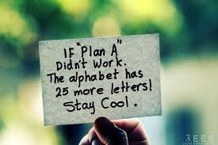
Key Questions in Creating a Custom Segmentation System
How good is my newly minted segmentation system?
Do the groups or segments that were created differ in terms of the values of the statistical drivers?
Do the groups or segments that were created differ in terms of the values of variables other than the statistical drivers
Do the groups or segments make logical sense?
Are they sufficiently different from each other that they are useful

Slide 32
Summary

Slide 33
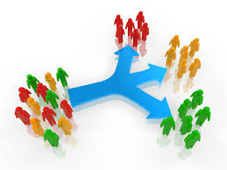
Summary of Key Points
Mass marketing versus market segmentation
Off-the-shelf versus custom segmentation systems
What is an index?
How custom segmentation systems are created and evaluated

